Slide 1

TEAM CHARMANDER
TECHGIG
NATIONAL LEVEL STARTUP HACKATHON
An organic innovation tech team to help everyone
2022

Slide 2
OUR COMPANY
NATURALEZA
Naturaleza is the organic tech company trying to educate everyone about organic products and help them in buying right products for them.Wait is that all about us no we also share some of the tasty recipe for everyone we are trying to make some revolution in organic technology.

Slide 3

WHAT WE ARE WORKING ON
HEALTH
FOODSTA
ORGANIC STARTUPS
Everyone know organic products are good but do they know why so?
Encouraging and setting new trend for the new generation.
Helping other organic startups by giving them platform for advertisement

Slide 4
ABOUT THE PROJECT
IT IS A WEB PROJECT WHERE THE FOLLOWING THINGS WILL BE INCLUDED:
Health benefits and uses of organic products
A platform for promotional purposes for start-ups (only organic or environment-related startups).
Foodsta (the entertaining thing) ; where users can share their recipes and images of their food or places and get likes and comments just like insta , facebook and other social media , so basically is a social media only for yummy food made organically or by their own related to healthy things.
A feedback or a query portal; where problems of the users will be taken

Slide 5
—Joshua Kushner
“Healthcare is yet to be transformed by technology.”

Slide 6
MAJOR REQUIREMENTS
FUNDING
USER EXPERIENCE
INFORMATION
Funding are required to bring our own services for the customers.
For a more user friendly experience we aim to provide a mobile application as soon as possible
Want to help NGOs and some other helping organisations to build a better community.

Slide 7
FUTURE GOALS AND VISION
With our vision, we have a lot of potential. With our short-term goal, we will be trying to become a small eCommerce company that will connect small ventures which are specialized in customizing with our user’s requirements, and then gradually we will keep expanding and become a large company with a huge user base.
We also aim to improve our surroundings with continuous tips that our users can practice in their daily life to improve their health as well the surroundings because we believe that our quench for a better environment needs to start from ourselves.

Slide 8
SNEAK PEEK
HEADER
TEXT
SLIDER
ICONS

Slide 9
PROJECT STAGES
STEP 2
STEP 1
STEP 3
Want to bring a big revolution between nature and technology.
A great idea just come in mind and we just started working on it.
Trying to collab with some of the brands and bring great user experience.

Slide 10
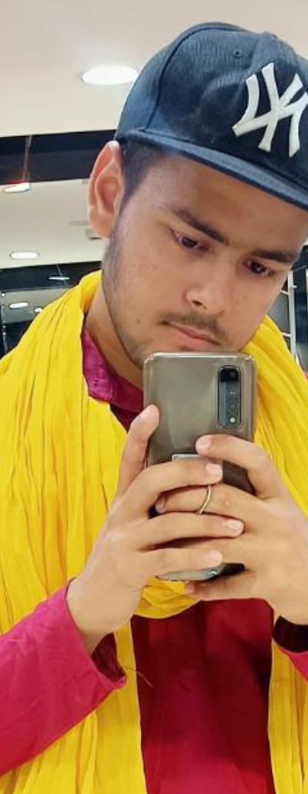
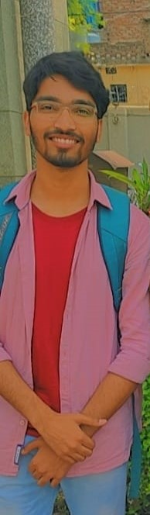
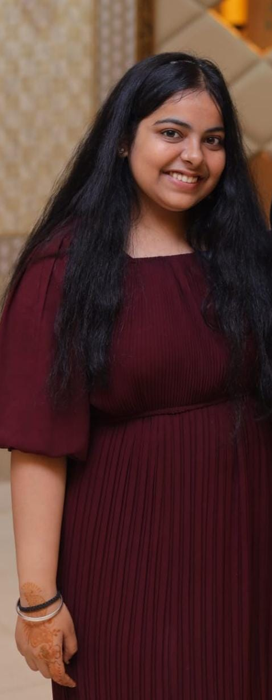
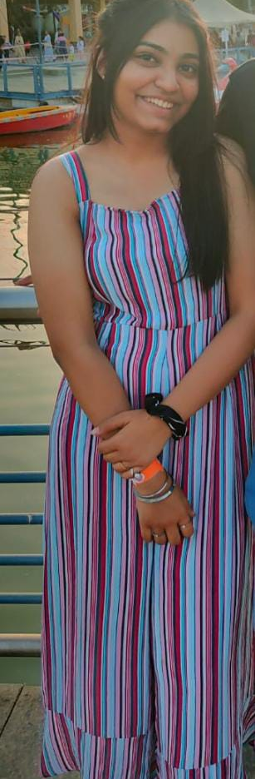
THE TEAM
TISHA THAKRAL
ABHISHEK
Narottam Choudhary
HARMEET KAUR KAPOOR
(Research and Tech team)
(Research , presenter )
(Research and Tech team)
(Team head, lead coder)

Slide 11
THANKS!
Special Thanks to
1)Meet Kataria
2)Abhay Chandra
3)Jasmeet Singh
4)Ritisha Garg

